Slide 1
Consumer Sentiment Prediction oneAPI
BlackBird
Ashish Anil Waykar

Slide 2
Approach To Predict Consumer Sentiment
Step 1 :
Data Analysis And Preprocessed Data.
Step 2 :
Created pipeline for every type of output as per title and headline.
Splitted pipeline as per KNeighborsRegressor & RandomForestRegressor.
Step 3 :
Processed the both model to fit it in pipeline.
Step 4 :
Got the time takes to the complete computations for fitting the model.
Step 5 :
Predicted the data And Acquired the prediction accuracy.

Slide 3
Architecture – Impact of oneAPI/oneDaal & skearnx
DAAL4Py Architecture :
DAAL4Py is built on top of the Intel DAAL library, which provides highly optimized algorithms for data analytics.
DAAL4Py provides a Python interface to the Intel DAAL library, which allows Python users to take advantage of the high-performance algorithms in the Intel DAAL library without having to write low-level C++ code.
DAAL4Py is designed to take advantage of Intel processors, which provide hardware acceleration for certain machine learning tasks.
DAAL4Py is designed to be easy to use, with a simple and consistent API that is similar to the scikit-learn API.
With intel DAAL4Py we have an access of several machine learning algorithms that all are mentioned in documentation[1].

Slide 4

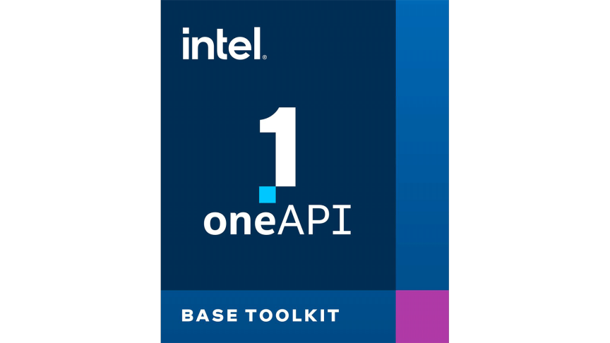
Approach Virtulisation
Dataset input
Dataset Layer
Data Preprocessing
Preprocessing Layer
( Dataset Analysis Removal Redundancies & anomalies )
Created Pipeline
Using XGBOOST MultiOutputRegressor
Pipelining Layer
( Pipeline Development for Prediction Engine )
Processing Layer
( Configured Pipelining With Respect To Algorithm Used For Training The Data )
Scikitlearn :
RandomForestRegressor
KNeighborsRegressor
train_test_split
Scikitlearn-intelx:
RandomForestRegressor
KNeighborsRegressor
train_test_split
Daal4py (Intel OneDaal) :
RandomForestRegressor
KNeighborsRegressor
_daal_train_test_split
Model Training Layer
(Model Fitting Using Developed Pipelining Architecture & Processed The Model Training With Respect To Library )
Model Fitting
Acquired Predicted Accuracy Scores
Accuracy Analysis Layer
Compared All Libraries
Accuracy Comparison Layer
For each model with respect to time & prediction accuracy score
Presentation Title

Slide 5
Core components of oneAPI used ensemble methods in the project
DAAL4Py Architecture Used For get the Best Accuracies :
daal4py.sklearn.neighbors.KNeighborsRegressor
daal4py.sklearn.ensemble.RandomForestRegressor
daal4py.sklearn.model_selection._daal_train_test_split
Intel Optimised SKL Architecture Used For get the Best Accuracies (scikit-learn-intelex):
sklearn.neighbors.KNeighborsRegressor
sklearn.ensemble.RandomForestRegressor
sklearn.model_selection. train_test_split
SKL Architecture Used For get the Best Accuracies :
sklearn.neighbors.KNeighborsRegressor
sklearn.ensemble.RandomForestRegressor
sklearn.model_selection. train_test_split
XGBOOST
NLTK

Slide 6
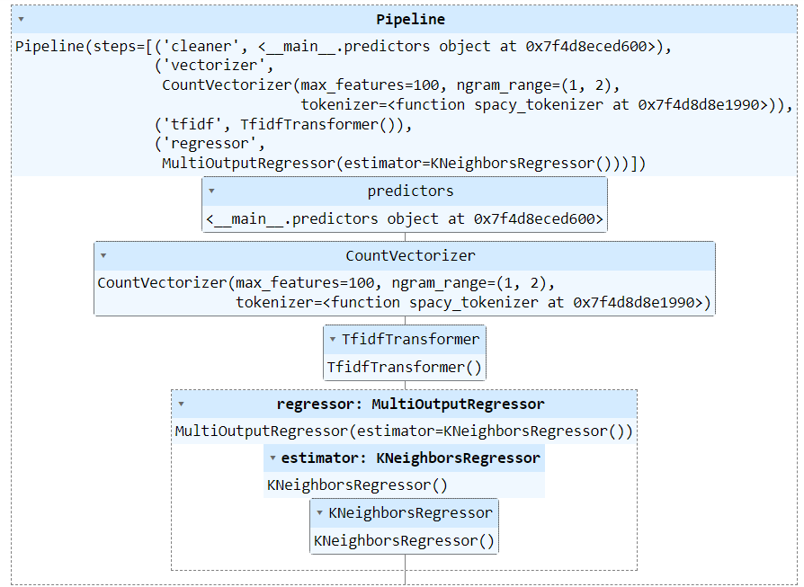
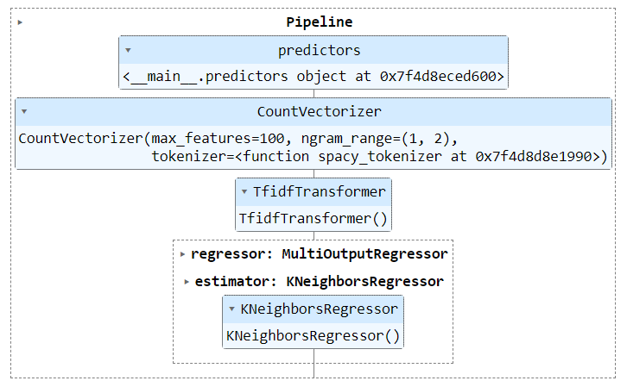
Core components of oneAPI used ensemble methods & Pipelining Architecture in the project
Used Algorithm With Pipeline :
KNeighborsRegressor
Used With Both Scikit learn & DAAL4PY
Used For :
SentimentTitle Prediction KNeighbors
SentimentTitle Prediction Pipeline : SKL & DAAL4PY
With KNeighborsRegressor

Slide 7
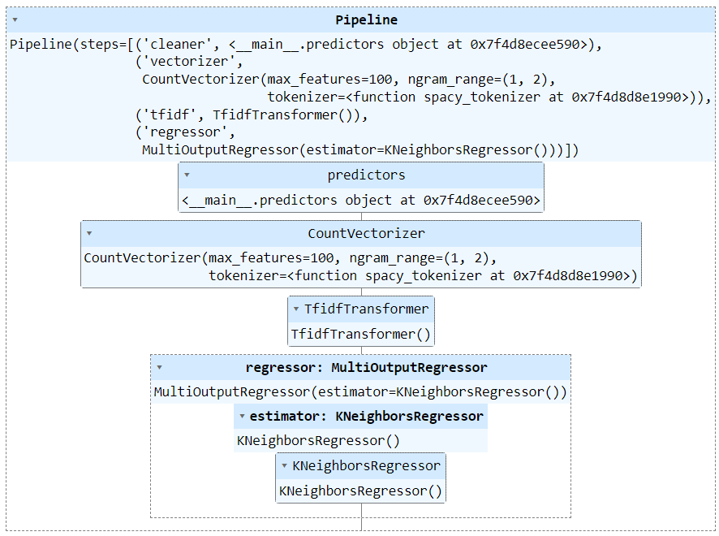
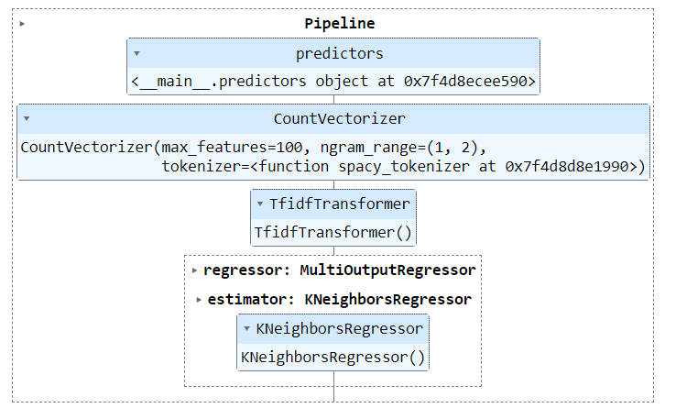
Core components of oneAPI used ensemble methods & Pipelining Architecture in the project
Used Algorithm With Pipeline :
KNeighborsRegressor
Used With Both Sikit learn & DAAL4PY
Used For :
SentimentHeadline Prediction KNeighbors
SentimentHeadline Prediction Pipeline : SKL & DAAL4PY
With KNeighborsRegressor

Slide 8
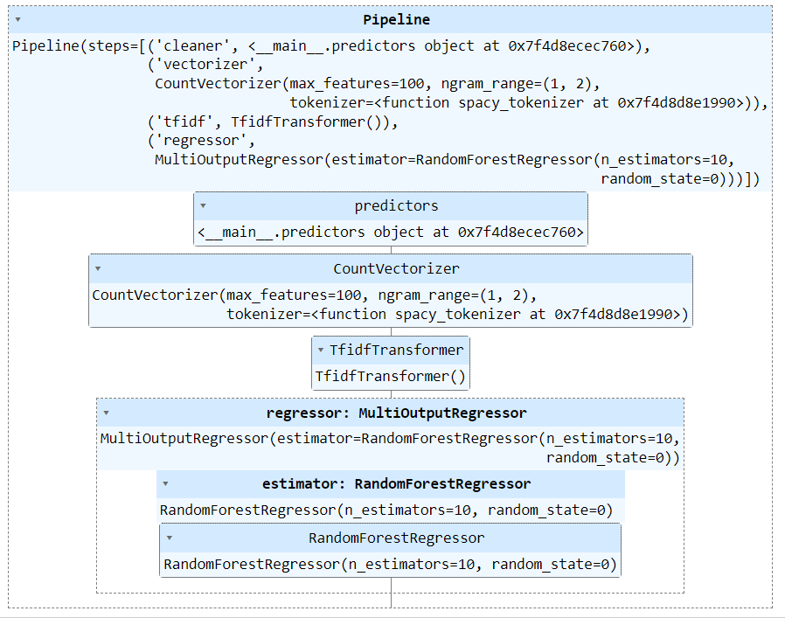
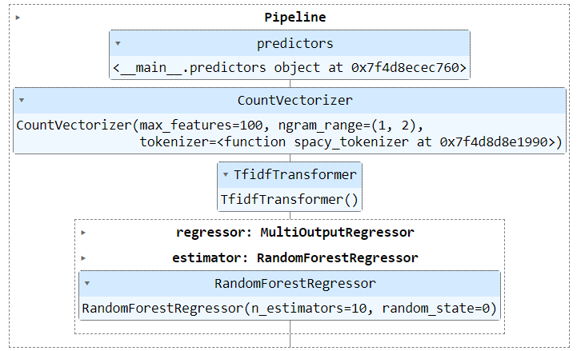
Core components of oneAPI used ensemble methods & Pipelining Architecture in the project
Used Algorithm With Pipeline :
RandomForestRegressor
Used With Both Sikit learn & DAAL4PY
Used For :
SentimentTItle Prediction Randomforest
SentimentTitle Prediction Pipeline : SKL & DAAL4PY
RandomForestRegressor

Slide 9
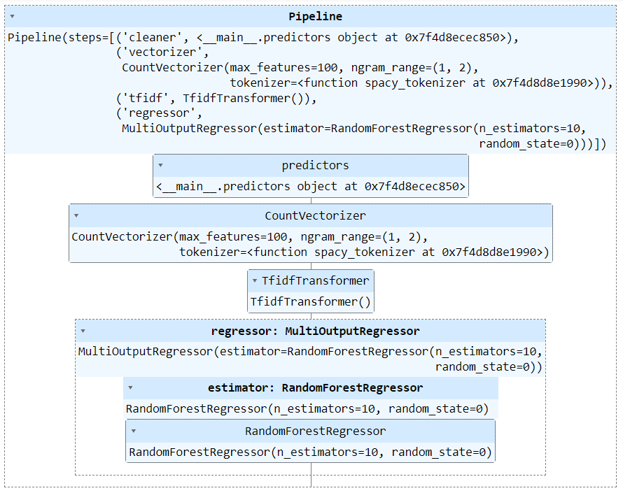
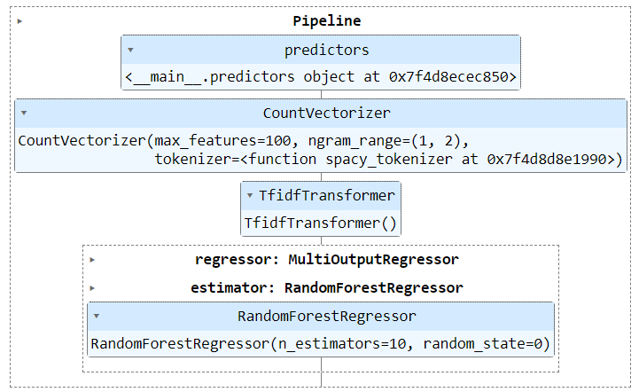
Core components of oneAPI used ensemble methods & Pipelining Architecture in the project
Used Algorithm With Pipeline :
RandomForestRegressor
Used With Both Sikit learn & DAAL4PY
Used For :
SentimentHeadline Prediction Randomforest
Sentiment Headline Prediction Pipeline : SKL & DAAL4PY
RandomForestRegressor

Slide 10
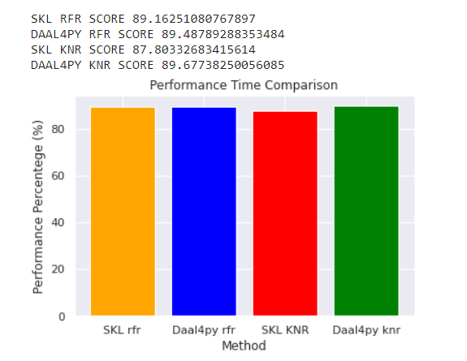
Results Summary(focus on Performance comparison of Scikit-learn vs Intelx-sicikit-learn )
Used Algorithms With Comparisons Output Accuracy :
RandomForestRegressor : SKL & DAAL4PY
KNeighborsRegressor : SKL & DAAL4PY
Output Formats Predictions :
SentimentTitle Prediction : SKL & DAAL4PY
SentimentHeadlinePrediction : SKL & DAAL4PY
Performance Comparison daal4py & Sklearn

Slide 11
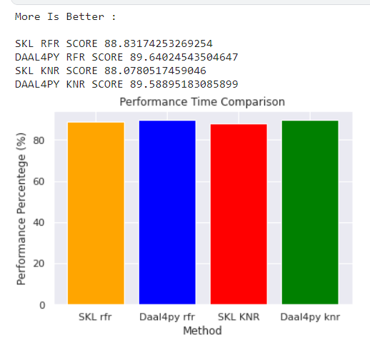
Results Summary(focus on Performance comparison of Scikit-learn vs Intel OneDaal )
Used Algorithms With Comparisons Output Accuracy :
RandomForestRegressor : SKL & DAAL4PY
KNeighborsRegressor : SKL & DAAL4PY
Output Formats Predictions :
SentimentTitle Prediction : SKL & DAAL4PY
SentimentHeadlinePrediction : SKL & DAAL4PY
Performance Comparison daal4py & Sklearn

Slide 12
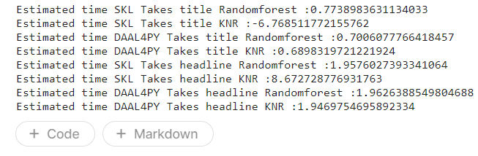
Results Summary(focus on unique aspects of Intelx-sicikit-learn)
Used Algorithms With Comparisons Output Accuracy :
RandomForestRegressor & KNeighborsRegressor
Used Algorithms With Comparisons Output Accuracy :
RandomForestRegressor : SKL & intelx-sicikit-learn
KNeighborsRegressor : SKL & intelx-sicikit-learn
Output Formats Predictions :
SentimentTitle Prediction : SKL & intelx-sicikit-learn
SentimentHeadlinePrediction : SKL & intelx-sicikit-learn
Performance Comparison With Respect To Time daal4py & Sklearn

Slide 13
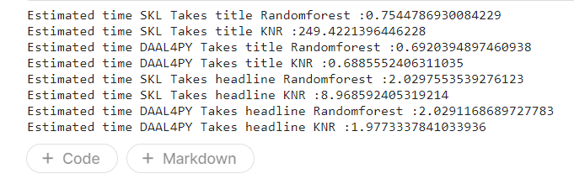
Results Summary(focus on unique aspects of Intel OneDaal )
Used Algorithms With Comparisons Output Accuracy :
RandomForestRegressor & KNeighborsRegressor
Used Algorithms With Comparisons Output Accuracy :
RandomForestRegressor : SKL & DAAL4PY
KNeighborsRegressor : SKL & DAAL4PY
Output Formats Predictions :
SentimentTitle Prediction : SKL & DAAL4PY
SentimentHeadlinePrediction : SKL & DAAL4PY
Performance Comparison With Respect To Time daal4py & Sklearn

Slide 14
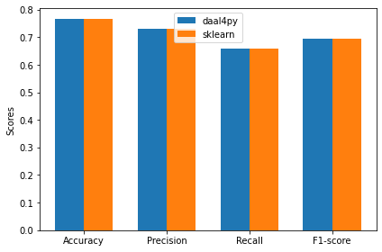
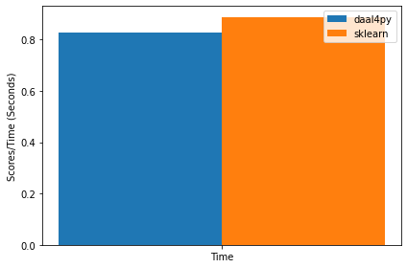
Results Summary(tried to compare output with respect to time and performance)
Performance Comparison With Respect To Time daal4py & Sklearn
Performance Comparison daal4py & Sklearn

Slide 15
GitHub Link(Codes should be public and available after hackathon also)
Round 2 :
Github [1] daal4py (oneDaal):
https://github.com/Ashish-Waykar/INTEL-OneApi/blob/main/oneapi-sentiment-prediction%20finaized%20(3).ipynb
Github [2] (intel optimised sikitlearnx ) (scikit-learn-intelex) :
https://github.com/Ashish-Waykar/INTEL-OneApi/blob/main/oneapi-sentiment-prediction%20(5)%20with%20intel%20optimised%20sikitlearnx%20.ipynb
Github [2]:
https://github.com/Ashish-Waykar/Consumer-Sentiment-Prediction-System/blob/main/OneAPI.ipynb
Dataset Raw :
https://raw.githubusercontent.com/Ashish-Waykar/DSA/main/training_data_sentiment.csv

Slide 16
Refferances
ONEAPI:
https://www.intel.com/content/www/us/en/developer/articles/release-notes/distribution-for-python-release-notes.html
Intel OneDaal ( daal4Py ) https://intelpython.github.io/daal4py/algorithms.html https://intelpython.github.io/daal4py/sklearn.html#scikit-learn-api https://intelpython.github.io/daal4py/index.html https://intelpython.github.io/daal4py/scaling.html#supported-algorithms-and-examples
Intel Optimized Scikit-learn (scikit-learn-intelex):
https://pypi.org/project/scikit-learn-intelex/
Scikit-Learn : https://scikit-learn.org/stable/modules/generated/sklearn.neighbors.KNeighborsRegressor.html
https://scikit-learn.org/stable/modules/generated/sklearn.ensemble.RandomForestRegressor.html
https://xgboost.readthedocs.io/en/stable/python/python_api.html
https://scikit-learn.org/stable/modules/generated/sklearn.base.TransformerMixin.html
https://scikit-learn.org/stable/modules/generated/sklearn.feature_extraction.text.TfidfVectorizer.html
https://scikit-learn.org/stable/modules/generated/sklearn.feature_extraction.text.TfidfTransformer.html
https://scikit-learn.org/stable/modules/generated/sklearn.feature_extraction.text.HashingVectorizer.html

Slide 17
System Requirements
RAM : 4GB
ROM : 10Gb Disk Space
CPU:
i5 Gen 11+ CPU
GPU:
NVIDIA GTX 1650 or intel® Iris(R) integrated Graphics
Due to heavy computation , heavy RAM , heavy Memory need to train & test The model i'm unable to add these code to in web application.
Rather then, i am going with kaggle servers jupyter notebook presentation with 30GB ram & 100GB+ storage

Slide 18
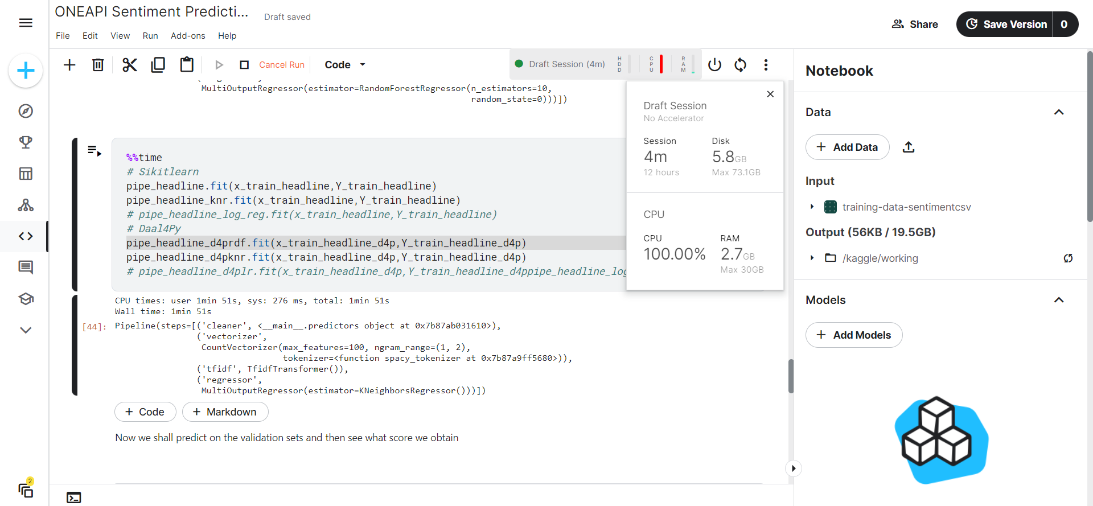
Requirements

Slide 19
Purposed Model Views Template (MVT) Django Framework
API Models
Templates
Requesting API
User Input (Text)
Views
Complete Data Response
Display Data

Slide 20


MVT + Machine Learning Framework
Django : Frontend
Flask : Backend API Responses from jupyter notebook
API Models
Templates
Requesting API
User Input (Text)
Views
Extract the Data
Display Data Predictions
Preprocessing
Acquired Output
Text Frequency Distribution
Fitted model pipelining
Machine Learning
Model PKL

Slide 21
Thank you

